Slide 1
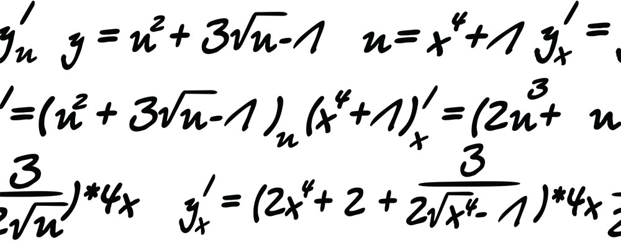

My Algebra
Interactive Notebook
Ms. Latham

Slide 2
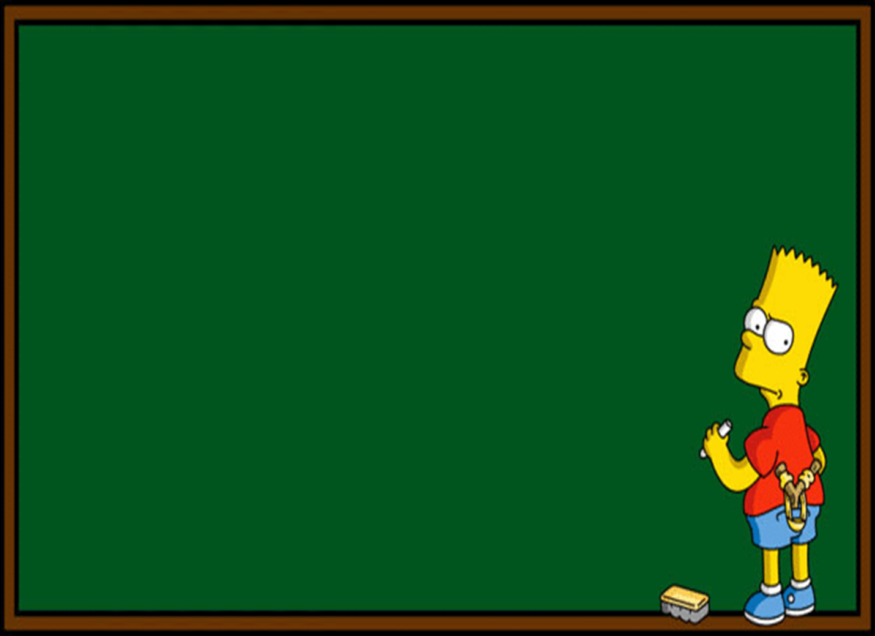
Lesson Objectives
TODAY – Review
We are tying in all of our knowledge so far!
Practice writing mathematical expressions from words
Practice substitution
Using our knowledge of commutative law and associative law comment on the expressions

Slide 3
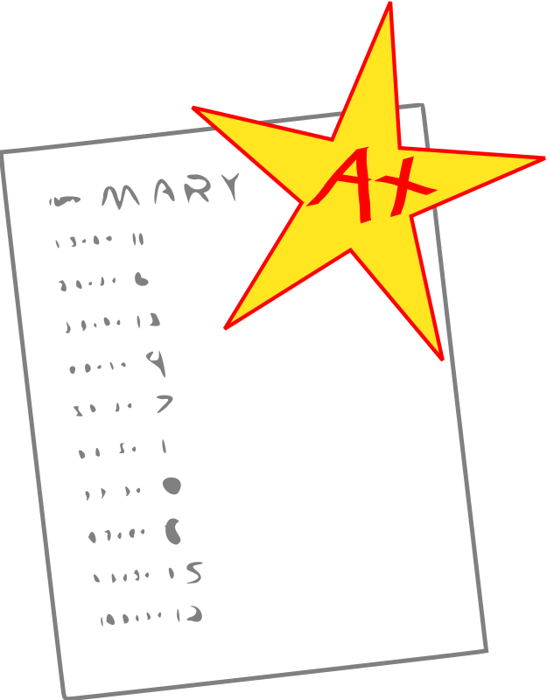
1st Activity
In pairs, working together you will match the word that shows on the screen to the correct operation
Then the answer will be revealed on the screen and your pair will earn a point. Keep track of your points!
Notes:
Each pair will need a whiteboard and marker and try to have them work without their glossaries initially.

Slide 4
Word:
Total

Slide 5

Answer:
$$+$$

Slide 6
Word:
Difference

Slide 7

Answer:
$$−$$

Slide 8
Word:
Share

Slide 9

Answer:
$$÷$$

Slide 10
Word:
Sum

Slide 11
Answer:
$$+$$

Slide 12
Word:
Product

Slide 13

Answer:
$$×$$

Slide 14
Word:
Decreased By

Slide 15
Answer:
$$−$$

Slide 16
Word:
Increased By

Slide 17
Answer:
$$+$$

Slide 18
Word:
Quotient

Slide 19
Answer:
$$÷$$

Slide 20
Word:
Less Than

Slide 21
Answer:
$$−$$

Slide 22
Add up your scores!

Slide 23


2nd Activity
In pairs, working together you will turn the sentence into a mathematical expression using letters and symbols
Then the answer will be revealed on the screen and your pair will earn a point. Keep track of your points!

Slide 24
Use (n) to represent number

Slide 25
Sentence:
A number plus 5

Slide 26
Expression:
n + 5

Slide 27
Sentence:
A increased by 7

Slide 28
Expression:
n + 7

Slide 29
Sentence:
A number decreased by 3

Slide 30
Expression:
n - 3

Slide 31
Sentence:
The sum of a number and 12

Slide 32
Expression:
n + 12

Slide 33
Sentence:
The product of a number and 65

Slide 34
Expression:
n × 65

Slide 35
Sentence:
Double a number

Slide 36
Expression:
n × 2

Slide 37
Sentence:
Half of a number

Slide 38
Expression:
n ÷ 2

Slide 39
Sentence:
6 less than a number

Slide 40
Expression:
n - 6

Slide 41
Sentence:
A number increased by 43

Slide 42
Expression:
n + 43

Slide 43
Sentence:
A number take away 10

Slide 44
Expression:
n - 10

Slide 45
Sentence:
A number by 7

Slide 46
Expression:
n × 7

Slide 47
Add up your scores!

Slide 48

3rd Activity
Return your whiteboards
In pairs or individually
Working on Exercise 7.7 and Exercise 7.8 page 94
We will do the first question together
Notes:
Each pair will need a dwyer text

Slide 49
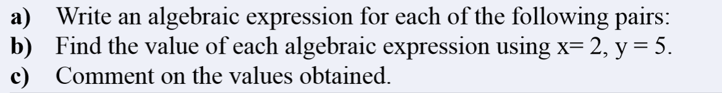
Exercise 7.7 page 94
For every question these 3 parts need to be done.
Question 1 - y plus seven and seven plus y
y + 7 and 7 + y
Put the value for 5 in for y
5+7 = 12
7+5 = 12
c) y + 7 and 7 + y is commutative
Notes:
Keep this up while the students are working as a reference.

